Slide 1
Oulu International School Info Evening for New Applicants and Their Guardians
1. General info about Oulu International School (OIS)
2. Applying to school and language proficiency tests
3. Special features of OIS
4. Daily school life at OIS
Principal Jenni Alaniemi
PYP (Gr 1-6) Coordinator Heidi Tuomela
MYP (Gr 7-9) Coordinator Marja Peedo
School administrator Kati Tiikkainen

Slide 2
1. General info about Oulu International School (OIS)

Slide 3
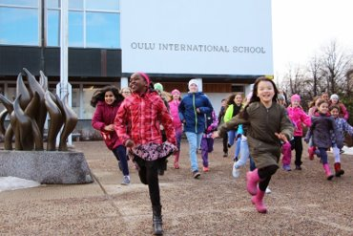
Our School
Public multicultural school ​
IB World School​
Primary (PYP) and Middle (MYP) years programmes​
Finnish national core curriculum​
Language of tuition English​
CLIL school​; All teachers are language teachers
437 students from more than 42 countries with over 37 different languages 46 staff members​
Grades 1 to 9
Transfer class and Individual learning path group

Slide 4
OIS within Educational Field
National Board of Education
National Core Curriculum
University of Oulu training school
Aptitude test school for other universities
IB Framework
OIS
CLIL teaching
IB Organization
City of Oulu
Curriculum
Department of Education

Slide 5
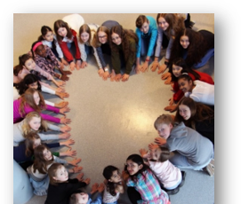
OIS Mission
”Joy of learning in a diverse and caring community”
OIS values​
Respect​
Responsibility​
Community​
Joy of Learning

Slide 6
2. Applying to school and language proficiency tests

Slide 7
How to Apply and what are the language tests like?
https://www.ouka.fi/oulu/oulu-international-school/how-to-apply-to-ois

Slide 8
3. Special features of OIS

Slide 9
Our students
-Study English as a mother tongue (3-4 lessons per week)
-Study Finnish as a mother tongue (FMT) or as a second language (FSL)
(3-6 lessons per week)
-Study all subjects mostly in English (CLIL)
-Study Swedish from gr 6 to gr 9
-Have more language lessons per week compared to other schools in the Oulu area.
-Have less optional subjects, as language lessons are part of them.
→ Students who like learning languages and reading, find the rigorous IB programme and studying several languages enjoyable.

Slide 10
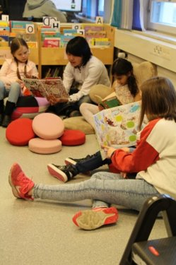
Transdiciplinary Learning in an IB school
Units built around phenomena and concepts​
Holistic inquiry-based approach​
  Phenomena and concepts examined from different points of view​
Deep learning ​
  Teaching transfer skills and connecting learning to everyday life​
  Emphasizing critical and creative thinking, inquiring and reflection​
Assessment​
  not only content knowledge → transdisciplinary skills and IB approaches to learning​
  e.g. creative thinking, research and social skills

Slide 11
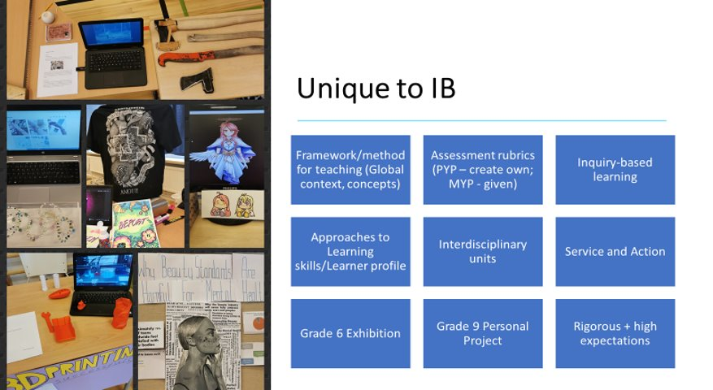

Slide 12
4. Daily school life at OIS

Slide 13
School days
Between 8.15-16.00
  Some voluntary mother tongue lessons take place outside school hours
  Students cannot stay at school outside their class timetable.
3-7 lessons per day depending on the grade level
21-33 lessons per week depending on the grade level and amount of optional languages

Slide 14
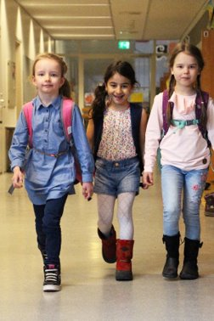
Afternoon care services
You can apply for a place for your child in afternoon services if your child is a 1st or 2nd grade student or if your child studies in grades 3-9 classes and has a special support decision (erityisentuen päätös).
An afternoon care place can be granted if the child's guardian(s) work or study or there is another special reason for needing the place.
You can apply for an afternoon care place for your child for the next school year on January 1st - February 15th 2023 in the Wilma system with a Wilma ID. The application form for afternoon activities is on the Applications and decisions tab. If necessary, you can get a paper application form from Oulu10 services (Torikatu 10).
120 €/month (August-May) (with exceptions) including insurance, teaching and material costs, and snack.
More information https://www.ouka.fi/oulu/koulutus-ja-opiskelu/aamu-ja-iltapaivatoiminta

Slide 15
School Clubs
OIS School Clubs are organized throughout the school year.
  The club info is sent in Wilma.
  The clubs are targeted mainly to grade 3-6 students.
  Usually one to two clubs per week after school hours.

Slide 16
Open Afternoon care services in the city of Oulu
Children can spend afternoons at youth facilities in different parts of the city. The facilities are open for elementary school children on weekdays, as a rule, from 12:00 to 17:00.
The age recommendation varies between different youth facilities, but in general the services are targeted for 7–17-year-old children.
Trained adult counselors work in the youth facilities. In the premises, you can play games, do homework and participate in guided activities. If the child wishes, they can bring their own lunch.
The services are the so-called open-house services, i.e., the parents and the child agree between themselves when the child enters and leaves the youth facility.
More information https://www.nuortenoulu.fi/vapaa-aika/nuorisotilat/ and https://www.ouka.fi/oulu/koulutus-ja-opiskelu/avoin-iltapaivatoiminta-nuorisotiloilla

Slide 17
Things to consider when applying to OIS
How will our family’s daily life look like in practice?
  How does my child commute to school and home?
  How much time does my child or I need to spend on commuting?
  How much time is left for homework, hobbies, friends and relaxing?
  How much time do I have to support my child with their daily reading and homework?
  What will my child’s network look like? Will their friends live close by or somewhere else?
What can I do to help my child in gaining more independence as a school child?
  Practice the journey to school and home first together then alone.
  Let my child do chores and tasks as independently as possible.
How will my child’s Finnish skills develop?
  What study options my child will have after gr 9 in Finland if their Finnish skills are not adequate enough for Finnish high schools or vocational schools?
How will my child’s mother tongue skills develop?

Slide 18
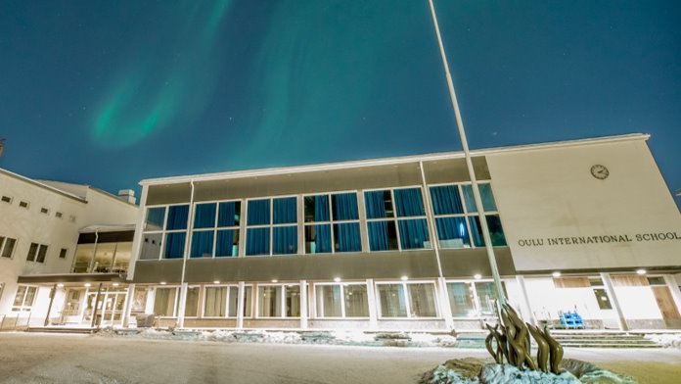
Thank you for your interest!

