Slide 1
Well-Being at School – supporting attendance in Oulu
Presentation Slides

Slide 2
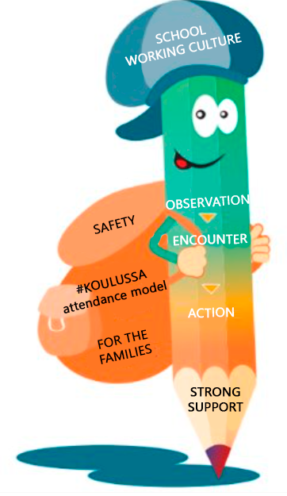
Supporting school attachment in Oulu's schools
An attendance support model has been developed for the city of Oulu's schools which includes instructions to support school attachment of students and prevent absences.
The model is called Well-being at Schools - supporting attendance in Oulu.
A student's school attachment is supported in cooperation with the student, guardians, teachers, student welfare services and networks.
The school can support a student's school attachment in three ways:
Pedagogically
Influencing community activities and structures
Student welfare services

Slide 3
Supporting school attachment on the community level Developing school working culture
Experience of participation, feeling of belonging in a community Caring adults Cooperation between school and home
Encounter
Relaxed atmosphere Pedagogical solutions that support well-being
Recognition of successes and strengths
Joy of learning
Structures support well-being and safety
Leadership with knowledge and skill Shared practices and structures in communities
Functioning cooperation with student welfare services

Slide 4
What to do when there is concern for a student? Preventative work for the student's benefit
Teacher observes the student's changed behavior
Teacher talks with the student about the changed behavior
Need for support is established together Consultation with student welfare services
The following slides discuss the topics: OBSERVATION, MEETING, ACTION
Notes:
Riitta:
Tässä diassa on ns. poissaoloihin puuttumisen osuus pähkinänkuoressa, eli se osa, jota opettajat käyttävät
Tämä dia on tehty siksi, että jos kouluissa halutaan, tätä voi käyttää esim. huoneentauluna
Samat asiat ovat sähköisessä versiossa, mutta tähän ne on kuvattu yhteen tulostettavaan muotoon hieman lyhyemmin
Tämä siis tulee käyttöönne

Slide 5
OBSERVATION Teacher observes the student's changed behavior
If examples are observed, the observation must be discussed with the student
PREDICTIVE EXAMPLES OF ABSENCES
Repetitive difficulties in departing for school
Difficulties in returning to school after a vacation or sickness leave
Increased contact home during a school day
Increase in tardiness
Individual absences from classes
Repetitive individual absences
Discontinued school days
Unauthorized absences
Repetitively forgetting to do homework
Student is present but does not participate
Changes in grades
Difficulties in transferring from one class to another
Repetitive will to leave the class
Difficulties with friends
Loneliness or withdrawal
Increased psychosomatic symptoms (stomach or head pain)
Changes in behavior and mood

Slide 6
ENCOUNTER Teacher talks with the student about the observation
Hey! How are you?
I have noticed that...
Teacher talks with the student about the changed behavior
to hear the student's own opinion
to understand the reasons behind the change in behavior
to offer support.
Considering how the student could be supported
pedagogically
by influencing the community's activities or structures
with student welfare services
The goal is supporting the student's well-being and school attachment.
What do you think?
Did some initiative come up based on the discussion?
Who could support you?
Thank you for sharing with me.

Slide 7
ACTION Multi-faceted mapping of the situation and an action plan
When an observation or absence has been brought up and there has been cooperation with the guardians, but
the concern continues
the reasons of the absences are uncertain or worrisome
the continuation of studies is under question due to the absences
unauthorized absences have not been cleared
unauthorized absences continue
What to do?

Slide 8
Alternative Actions A suitable multisectoral course of action is chosen for the situation
Consultation
Student welfare services or other specialists.
Evaluate the need for support:
Disciplinary education discussion, Lapset puheeksi discussion or other
At the latest when there is 30 hours of concerning absences
A case-specific multisectoral team of specialists is compiled
At the latest when there is 30 hours of concerning absences
Child protection services if needed
Network cooperation

Slide 9
Action Plan
Finding the cause of the change in behavior or absences
Compiling an action plan to support the child or young person.
Evaluating how we could support the student
pedagogically
by influencing community practices or structures
with student welfare services
Recording the courses of action in student welfare and pedagogical documents

Slide 10
STRONG SUPPORT Action plan to support school attachment
Student welfare support to meet the needs
The school's case-specific multisectoral team of specialists
Network meetings
Updating pedagogical support to meet the needs
We update the pedagogical support and pedagogical structures
We appoint contact and responsible persons to be liable for the overall picture of learning
We plan educational progression
Education content and goals: What do we study?
Realization of education: How are tasks done? How is teaching realized?
Physical location of education: Classroom and distance education?
Evaluation of education: What criteria? What evaluation methods?
Recording to pedagogical documents
Community support to meet the needs
Notes:
Oppilaalla voi olla tukiverkostoja ilman, että oppilashuollon palveluntuottajia on mukana. Se on verkostoyhteistyötä, eikä siinä synny oppilashuoltokertomusta.
Koulun työntekijä voi osallistua verkostotapaamiseen
kutsuttuna tai sopien verkostotapaamisesta huoltajien ja oppilaan kanssa.
Verkostotapaamiseen osallistunut koulun työntekijä voi kirjata oppilashuoltokertomukseen
koulun toiminnan kannalta olennaiset sopimukset huoltajien ja oppilaan luvalla
jos oppilashuoltokertomus on avattu
jos ko. koulun työntekijä kuuluu jo aiemmin perustettuun yksilökohtaiseen monialaiseen asiantuntijaryhmään.
Pedagogiset asiat kirjataan pedagogisiin asiakirjoihin.

Slide 11
Steps towards school
Contact to school activities and teachers
Contact to guardians and caring parties
We agree on who is responsible for contact
Encourage the student to contact the school
Regular contact
Lowering the barrier for coming to school and school attachment
Cooperation with the child or young person and their guardians
Considering the opinions of different specialists
Considering the school community's preparation and structures
Supporting school attachment

Slide 12
More information about learning and school support
Read more on the topic on the Support in Learning and Attendance webpage (ouka.fi)
Thank you!

